Slide 1

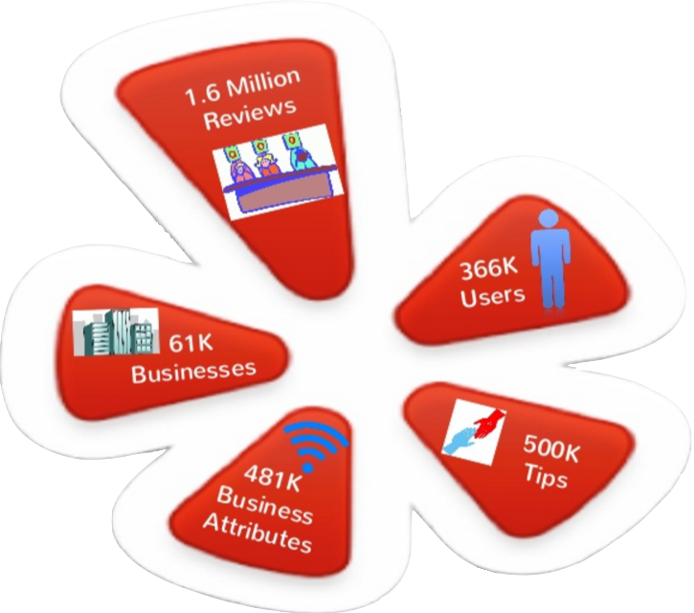
Yelp Data Analysis
Notes:
How many people use yelp?
How many read reviews?
How many write reviews?
We’ll walk through what attributes increase the probability of receiving higher stars for a business and what attributes increase the chance of a user getting more fans.

Slide 2
Team Information
Course – Big Data Systems Engineering Using Scala
Professor – Robin Hilyard
Team 7
Team Members: Prateek Mane Zhenchi Yuan
Notes:
How many people use yelp?
How many read reviews?
How many write reviews?
We’ll walk through what attributes increase the probability of receiving higher stars for a business and what attributes increase the chance of a user getting more fans.

Slide 3

Agenda
Goals
DataSet Description
Milestones
Data Cleansing
Tasks Description
User Reviews
Finding Business Competitors
Programming in Scala
Test Cases
Software To Be Used
Notes:
Converted from JSON

Slide 4
Goals
To understand sentiment of users
To help restaurants grow their business
Scalable
Provide Business Insight and Analytics to the business owner using data visualization techniques
Notes:
Converted from JSON

Slide 5
DataSet Description
Data Source: https://www.yelp.com/dataset_challenge
Data Format: JSON
Business – list of businesses
Basic Attributes (Business_id, name, categories)
Address (neighborhoods, full_address, city, state, latitude, longitude)
Reviews (stars, review_count)
Time (open: True/False, hours)
Review – list of customers’ review
business_id, user_id, stars, text, date, votes
User – list of users
User_id, name, review_count, average_stars, votes, friends, elite, yelping_since, compliments, fans
Notes:
Converted from JSON

Slide 6
Milestones
First Week <by Mar 25th,2016> Team Task
1. Creation of project repository
2. Software environment configuration
3. Requirement analysis and system structure design
Second Week <by Apr 1st, 2016> Assigned to Prateek
1. Parse JSON data and Data Cleaning
2. Map bigrams with business IDs
3. Finish sentiment analysis on bigrams.
4. Unit test cases
Third Week <by Apr 8th, 2016> Assigned to Hank
1. Business competitors analysis and Unit test cases
2. Recommendation system (if time permits)
Fourth Week <by Apr 15th, 2016> Team Task
1. Data Visualization and application deployment on AWS

Slide 7

Data Cleansing
Initial dataset:
61,184 business records
436 business categories
Illegal Characters
Interested:
Only in restaurant, food chain and eateries
Approx. 20,000 business records
Approx. 100 business categories
Reviews – 0.2 M
Users – 0.1 M

Slide 8
Tasks Description
User Reviews - to conclude all users’ review about one certain restaurant using visual ways.
Finding Business Competitors - to find out competitors in Neighbourhood

Slide 9
First Task - User Reviews
Bigrams
Create word clouds of positive and negative reviews.
Methods:-
http://thesaurus.altervista.org -> Synonyms generation
Stanford NLP -> POS Tagging
RDD manipulation
Sentiment Analysis On Bigram
Total count of positive and negative reviews.
Top or bottom 10 positive and negative words
Methods:
Stanford NLP -> Sentiment
Creating word arrays

Slide 10
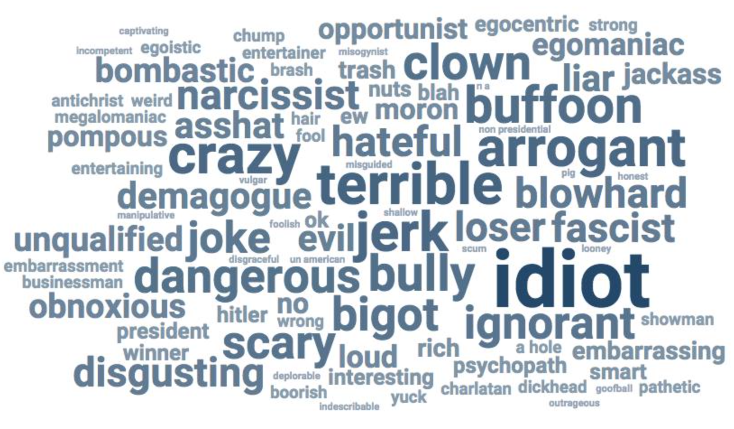
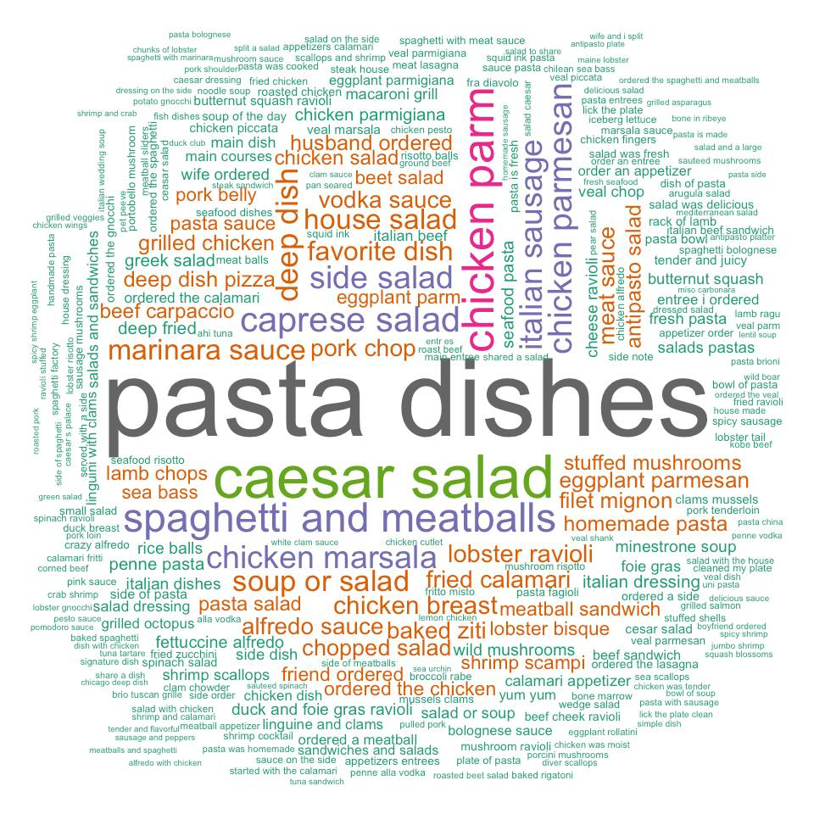
User Reviews - Word Clouds
Bigram – Negative words
Bigram – Positive words

Slide 11
Second Task - Finding Business Competitors
For a business, we look for similar nearby business to find out what advantages they have which helps out business to improve its competitiveness.
Factors to find Competitors:-
Geo location
Categories
E.g. –
Business – Qdoba Category – Mexican
Competitor
Name Distance Rating Advantage
Border Café 4 miles 4 stars unlimited tacos, cheap food

Slide 12
Second Task - Output

Slide 13
Programming in Scala
RossmanSalesPrediction (main class)
Call the Spark Context and initiate the other functions by providing the dataset
Model/StoreSalesDataFrame:
Format and datatypes of the dataframe.
Clean/DataAggregatorUtil:
Loading the training dataset and saving it to a dataframe.
Loading the test dataset and saving it to to a dataframe.
Clean/DataCleanerUtil:
Filtering the missing values and header records
Conversion to correct data formats
Algo/SalesPredictionUsageUtil:
Encoding of data columns (indexer/one hot encoder to convert labels to dummy variables).
Preparing pipelines for the respective models (linear regression/random forest regression).
Preparing and fitting the model.
Make predictions and save it as a file.

Slide 14
Test Cases
Spark Context should not be null
Training dataset should not be null
Test dataset should not be null
Training dataframe should not be null
Test dataframe should not be null
Random Forest Pipeline should have trainValidationSplit
Linear Regression Pipeline should have trainValidationSplit

Slide 15
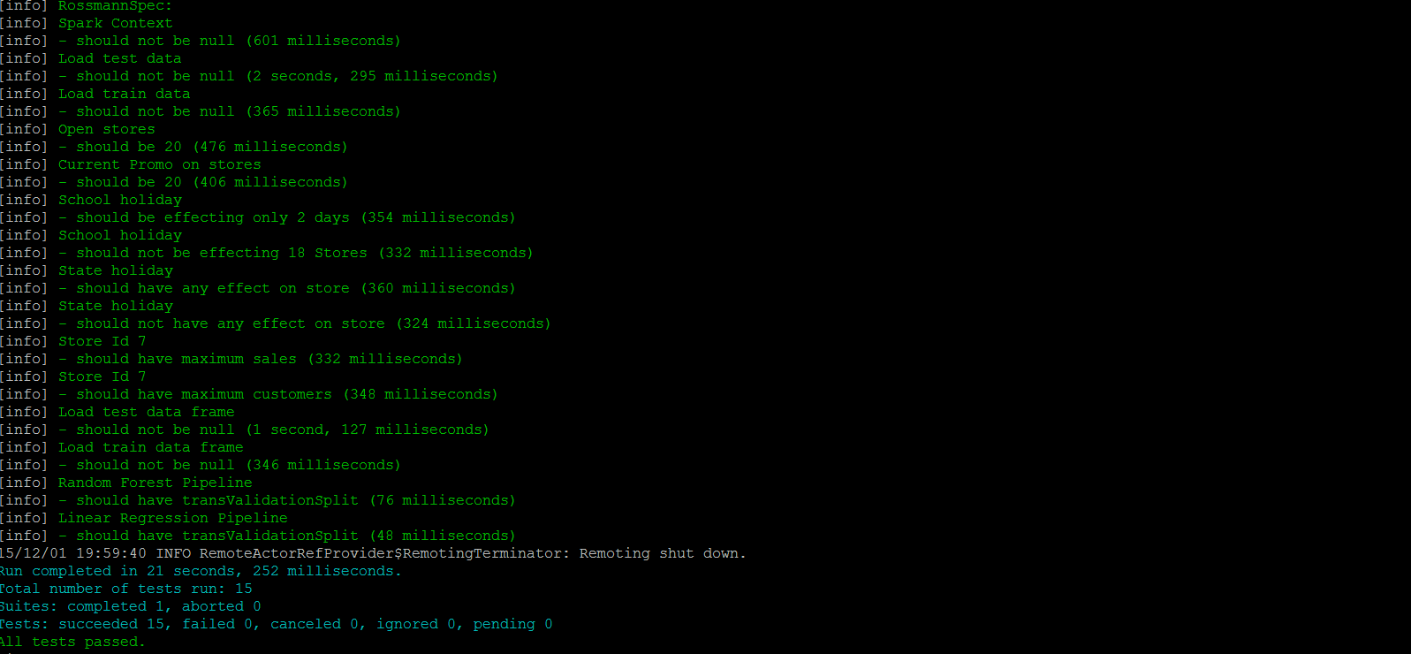
Test Cases Output

Slide 16



Software To Be Used
Notes:
Dependent variables: fans
Independent variables: review_count, average_stars, frequency of review (the number of the reviews per year)
All three independent variables are statistically significant to dependent variables.
Frequency_of_review is negative correlated with number of fans while review_count and averge_ stars are both positively correlated with the number of fans.
That is to say, while holding everything else constant, the more review the user writes, the more the number of fans the user will have.
And while holding everything else constant, the higher the average stars, the more the number of fans the user will have.
Since the frequency_of_review is negatively related to the fans, that is to say, while holding everything else constant, the more frequent the user write a review, the less the number of the fans the user will have.
Users behave differently. Someone who has been a user for a shorter period (2 years) could write the same number of reviews as the one that has been a user for a longer period (5 years). The former might just write reviews too frequently, so their reviews might have a lower quality. And that might be a reason that they has smaller number of fans than the one that write the review less frequently.

Slide 17

QUESTIONS?

